Slide 1
K Means Challenges

Slide 2
K mean seems easy but does have challenges
Though the main motive of k means algorithm is to reduce the sum of squared errors so that the data points are clustering according to the nearest distances , they do show some challenges.
One of the common challenge is the computational challenge of computing the centroid point to figure out the data points by checking the distance between the centroid and re assigning the centroid so as to minimize the sum of squared errors.
What can be other challenges rather than the computational challenges ?

Slide 3
Other challenges of K-Means
K means is sensitive to outliers :When there are outliers in the data, the k-means algorithm may incorrectly assign them to a cluster, causing that cluster's average position to be pulled towards the outlier. So ,This pull affects the calculations for other data points and can lead to inaccurate cluster assignments.
k-medoids method, PAM , Absolute error criterion
K means cannot be applicable to nominal data: The standard k-means algorithm is designed to work with numerical or continuous data. It operates based on calculating distances between data points using methods such as the Euclidean distance.
Since k-means relies on distance calculations, it does not have a straightforward way to handle nominal data. The algorithm requires a numerical representation of data points to calculate distances and update cluster centers.
To apply k-means to nominal data, preprocessing steps are typically required to transform the nominal data into a numerical format.
Alternative clustering algorithms that are specifically designed for categorical or nominal data, such as k-modes

Slide 4
Estimating the number of clusters
Elbow method , silhoutee methods can be used .
→The k-means algorithm assumes that the data points are linearly separable in the feature space. However, in real-world datasets, the underlying patterns can be nonlinear, making it challenging for k-means to find appropriate clusters. K-means tends to struggle when faced with data that exhibits complex structures or when clusters have irregular shapes.
Kernel K means approach is used to fix this limitation.

Slide 5
K-mediods
This method is used because the k means is sensitive to the outliers.
k-medoids uses actual data points called medoids as representatives of each cluster. Medoids are less affected by outliers
Absolute error criterion:The k-medoids algorithm uses an absolute error criterion, also known as the sum of dissimilarities, to measure the dissimilarity between data points and cluster centers. Instead of minimizing the squared distances as in k-means, k-medoids minimizes the sum of dissimilarities between data points and their assigned medoids. This criterion helps in handling outliers as it is less sensitive to extreme values.
Partioning around mediods:The main technique used in the k-medoids algorithm is Partitioning Around Medoids (PAM). PAM is an iterative process that starts with an initial random selection of medoids and then improves the clustering by iteratively swapping medoids with non-medoid data points and recalculating the sum of dissimilarities. The algorithm continues this process until a satisfactory clustering solution is achieved.

Slide 6
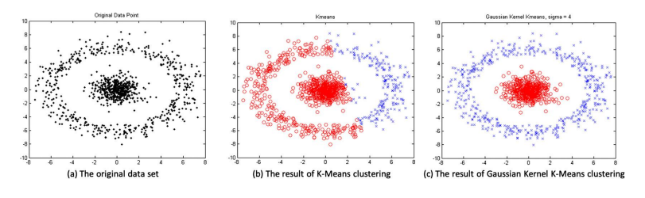
Kernel K mean
Kernel k-means addresses the limitation of k-means by utilizing the kernel trick.
It applies a nonlinear transformation to the input space, mapping the data points to a higher-dimensional feature space where linear separation becomes possible.
The kernel function allows the algorithm to implicitly compute the dot product between data points in the high-dimensional space without explicitly calculating the transformations.
Kernel k-means computes a similarity matrix, assigns data points to centroids based on kernel-induced distance, and updates centroids using the mean of assigned points. It captures complex structures and nonlinearity, providing a flexible clustering approach.

Slide 7
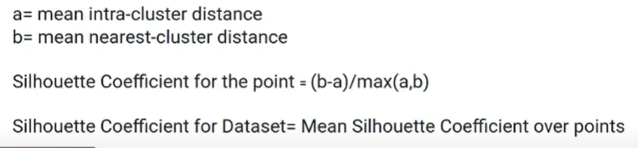
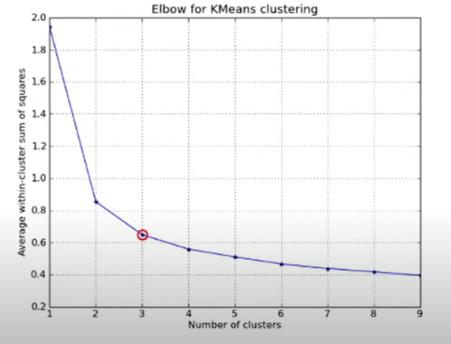
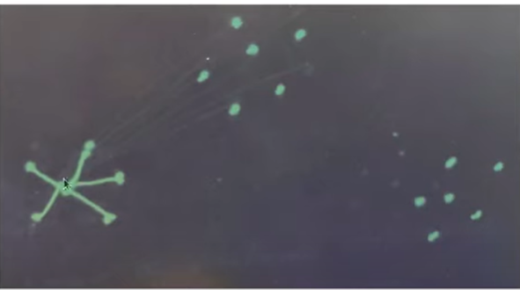
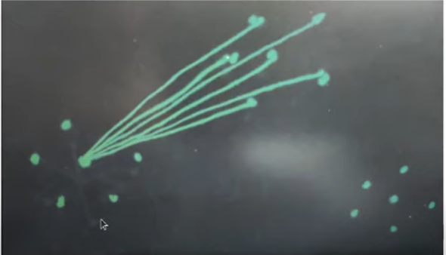
Elbow and silhoutee
For the elbow method, you need to calculate the mean squared error (MSE) or within-cluster sum of squares (WCSS) for different values of k. This requires running the k-means algorithm multiple times and calculating.
for the silhouette method, you need to calculate the silhouette coefficient for each data point in the dataset. This involves computing the distances and comparing data points within their assigned clusters and with neighboring clusters. To find the optimal number of clusters, you repeat this process for different values of k, which requires calculating the silhouette coefficient for all data points for each k value

Slide 8
K-MODES
This method is used because it is k means algorithm cannot deal directly with the nominal data.
Unlike numerical data, categorical data cannot be easily measured using distances or means. Therefore, k-means, which relies on distances and means, is not suitable for categorical data. In such cases, k-modes provides a more appropriate clustering solution.

Slide 9
Steps for K-mode
1. Pick an observation (instance) at random and use that as a cluster
2. Compare each data point in the cluster to each observation data points, any elements that are not equal we +1 if they are equal nothing is added
3. Assign each individual to the closest centroid
4. Each feature should have the mode (most common response)for each centroid
5. Repeat steps 2-4 until no changes are made in the assignment of individuals to the closest centroid

Slide 10
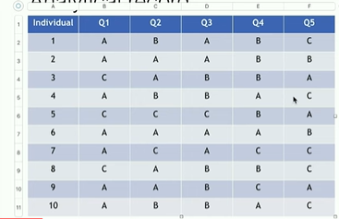
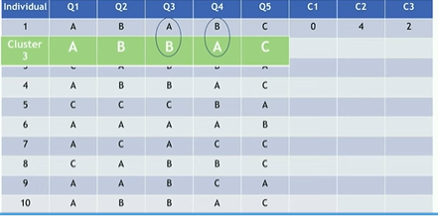
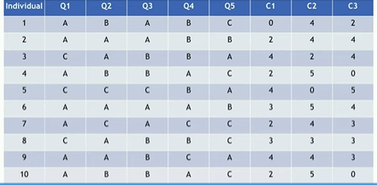

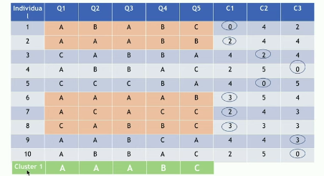
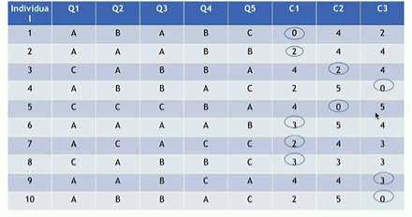

s1
s3
s4
s7
s2
s5
s6
REPEAT

Slide 11
CONCLUSION
ISSUE OF K –MEANS | SOLUTION
Sensitive to outliers | K-Mediods
Nominal Data | K-Mode
Optimal K value | Elbow Method/Sillhoutte Coefficient
If not linearly Separable | Kernel K Means

